Slide 1
How Watson Turned the Trick

Slide 2
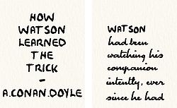

Slide 3
Baker Street Elementary
“How Watson Turned a Trick”
Copyright 2021 © by Joe Fay, Rusty Mason, and Steve Mason
1st Edition
Published in Dallas, Texas
All rights reserved. No part of this book may be reproduced, stored, or transmitted in any form or by any means without prior permission of the authors (which is not that hard to obtain), except for brief excerpts for reviews)

Slide 4
WATSON, YOU HAVE BEEN WATCHING ME INTENTLY FOR THE PAST SEVERAL MINUTES… WHAT ARE YOU THINKING ABOUT?
ABOUT YOU.

Slide 5
ME?
NOT CREEPY AT ALL.

Slide 6
YES, YOU HOLMES… I WAS THINKING HOW SUPERFICIAL ARE THESE TRICKS OF YOURS.
MY TRICKS?

Slide 7
YOUR TRICKS, AND HOW WONDERFUL IT IS OUR CLASSMATES SHOULD CONTINUE TO SHOW INTEREST IN THEM.
AND SOME DAY MAYBE EVEN MAKE UNTOLD FORTUNES OFF THE TRACKS?

Slide 8
I QUITE AGREE, WATSON… IN FACT, I HAVE A RECOLLECTION I HAVE MYSELF MADE A SIMILAR REMARK.
UHHH… NOT YET, YOU HAVEN’T.

Slide 9
I HAVE DETERMINED, IN MY OWN MIND, YOUR METHODS ARE REALLY EASILY ACQUIRED.
NO DOUBT… PERHAPS YOU WILL YOURSELF GIVE AN EXAMPLE OF THIS METHOD OF REASONING.

Slide 10
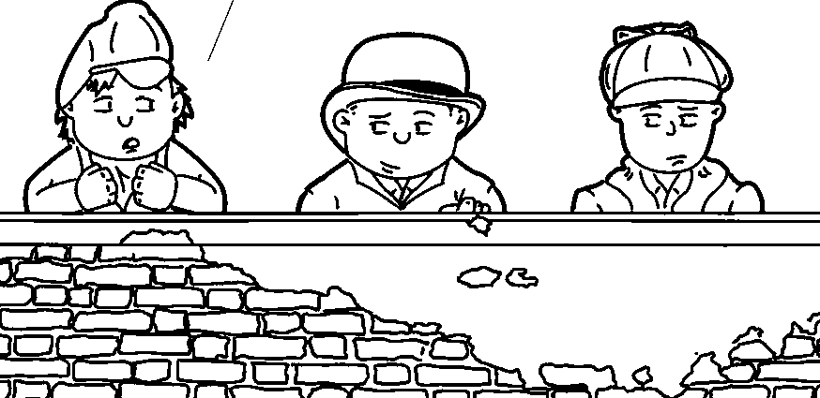
I’M STILL CONFUSED… ARE YOU DRAWING INDUCTIONS OR DEDUCTIONS?

Slide 11
I WILL GLADLY GIVE YOU AN EXAMPLE… I AM ABLE TO SAY YOU WERE GREATLY PRE-OCCUPIED WHEN YOU DRESSED THIS MORNING.
EXCELLENT! HOW COULD YOU POSSIBLY KNOW THAT?

Slide 12
BECAUSE YOU ARE USUALLY A VERY TIDY YOUNG LAD, AND YET YOU HAVE MISBUTTONED YOUR SHIRT, MISSING TWO OF THE BUTTON-HOLES.

Slide 13
INTERESTING… YOUNG STAMFORD HERE IS IN SUCH A DISORDERLY MANNER ALMOST EACH MORNING, BUT I DO NOT BELIEVE HIS PROBLEM IS PRE-OCCUPATION.

Slide 14
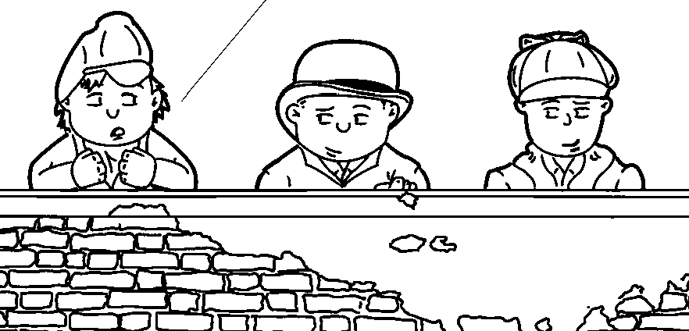
I’M NOT TALL ENOUGH TO SEE THE MIRROR IN OUR ROOMS… HARD TO GET IT RIGHT WHEN I AM LOOKING DOWN AT MY SHIRT.

Slide 15
WELL, WATSON… HOW VERY CLEVER… I HAD NO IDEA YOU ARE SO APT A PUPIL.
I AM DOING VERY WELL IN ALL MY SUBJECTS, I WILL HAVE YOU KNOW.

Slide 16
YES, YES… HAS YOUR EAGLE EYE DETECTED ANYTHING MORE?

Slide 17
I BELIEVE SO… YOU HAVE A NEW CLIENT NAMED BARLOW, AND TO THIS POINT, YOU HAVE NOT SUCCEEDED IN SOLVING HIS PROBLEM.
HOW COULD YOU POSSIBLY KNOW THAT?

Slide 18
I SAW THE NAME OUTSIDE OF THE ENVELOPE IN YOUR COAT POCKET… WHEN YOU OPENED IT JUST A WHILE AGO, YOU GAVE OUT A GROAN AND THRUST IT INTO YOUR POCKET WITH A FROWN ON YOUR FACE.

Slide 19
ADMIRABLE! YOU ARE INDEED OBSERVANT… ANY OTHER POINTS?
I THINK HE HAS ALREADY PROVED HIS POINT.

Slide 20
I FEAR, HOLMES, YOU HAVE TAKEN TO FINANCIAL SPECULATION, POSSIBLY OF A SLIGHTLY ILLEGAL BENT, ON OUR SCHOOL’S SPORTING EVENTS.

Slide 21
YOU’RE BETTING ON OUR RUGBY AND FOOTBALL TEAMS? YOU MAY AS WELL JUST GIVE YOUR MONEY TO ME TO LOSE.

Slide 22
HOW COULD YOU GAIN THAT OPINION, WATSON?

Slide 23
EARLIER TODAY, YOU OPENED UP THE SCHOOL NEWSPAPER, THE HOUND’S TOOTH, TURNED TO THE SPORTS PAGE, AND GAVE A LOUD EXCLAMATION OF INTEREST, SHOOK YOUR HEAD, AND SIGHED LOUDLY.

Slide 24
REALLY, WATSON, YOU ABSOLUTELY EXCEL YOURSELF… ANYMORE?

Slide 25
YES, HOLMES, YOU HAVE PUT ON YOUR BLACK DRESS COAT, INSTEAD OF YOUR GREY CASUAL COAT, WHICH PROVES YOU ARE EXPECTING TO MEET AN IMPORTANT CLIENT… POSSIBLY MASTER BARLOW.

Slide 26
I NEVER NOTICED YOU WORE DIFFERENT COATS FOR DIFFERENT EVENTS.
ANYTHING MORE?

Slide 27
I HAVE NO DOUBT I COULD FIND OTHER POINTS, BUT I ONLY GIVE YOU THESE FEW, IN ORDER TO SHOW YOU THERE ARE OTHER PEOPLE IN THIS SCHOOL WHO CAN BE AS CLEVER AS YOU.

Slide 28
AND SOME NOT SO CLEVER… I ADMIT THEY ARE FEW, BUT I AM AFRAID, MY DEAR WATSON, I MUST COUNT YOU AMONG THEM.

Slide 29
WHAT DO YOU MEAN?
WELL, MY DEAR FELLOW, I FEAR YOUR DEDUCTIONS HAVE NOT BEEN SO HAPPY AS I SHOULD HAVE WISHED.

Slide 30
YOU MEAN I WAS MISTAKEN?
ONE OF YOUR BETTER DEDUCTIONS, I WOULD SAY.

Slide 31
JUST A LITTLE THAT WAY, I FEAR… LET US TAKE THE POINTS IN THEIR ORDER.
THIS SHOULD BE GOOD.

Slide 32
I DID NOT USE ALL THE BUTTONS, AS I SUFFERED A RATHER PAINFUL PAPER CUT ON 3 OF MY FINGERS ON MY RIGHT HAND LAST NIGHT…
I BUTTONED THE MINIMUM AMOUNT TO KEEP MY SHIRT CLOSED, AS THE TRAUMATIZED AREA IS STILL VERY SENSITIVE…

Slide 33
I PUT ON MY BLACK COAT BECAUSE, I HAVE, WORSE LUCK, A LUNCH-TIME APPOINTMENT WITH MY FAMILY DENTIST TO PULL THE TOOTH THAT HAS BEEN HURTING ME FOR A WEEK OR SO…

Slide 34
LET ME RETRIEVE A PLIERS AND I CAN SAVE YOU A TRIP.
THANKS, BUT I THINK NOT.

Slide 35
THE DENTIST’S NAME IS BARLOW, AND THE LETTER CONFIRMS THE APPOINTMENT.
SORRY, JOHN, BUT IT’S SLOWING SLIPPING THROUGH YOUR FINGERS.

Slide 36
THE SCHOOL’S ‘SPORTING’ PAGE IS ADJACENT TO THE ‘CURRENT EVENTS’ PAGE…
…YESTERDAY, THEY RAN YOUR LATEST ATTEMPT AT CHRONICLING MY INVESTIGATION INTO THE CHOCOLATE CANDY THEFT IN THE ASSISTANT HEADMASTER’S OFFICE…

Slide 37
…MY PHYSICAL REACTIONS WERE A RESULT OF READING YOUR OVER-EXAGGERATIONS OF MY ACTIVITIES.
HOW DID I SENSATIONALIZE THE CASE?

Slide 38
YOU TOOK A FULL PAGE TO EXPLAIN SOMETHING WHICH TOOK ME TWENTY SECONDS, ONCE I ENTERED THE OFFICE, TO DETERMINE THE PERPETRATOR.

Slide 39
BUT GO ON, WATSON, GO ON! KEEP UP WITH THIS TRAIL YOU ARE ON.

Slide 40
IT IS A VERY SUPERFICIAL TRICK, AND NO DOUBT YOU WILL SOON ACQUIRE IT.

Slide 41
