Slide 2
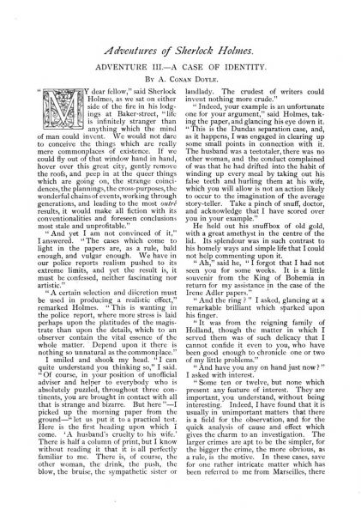

Slide 3
Baker Street Elementary
“A Case of Ipseity”
Copyright 2019 © by Joe Fay, Rusty Mason, and Steve Mason
1st Edition
Published in Dallas, Texas
All rights reserved. No part of this book may be reproduced, stored, or transmitted in any form or by any means without prior permission of the authors (which is not that hard to obtain), except for brief excerpts for reviews)

Slide 4
MY DEAR FELLOWS, LIFE IS INFINITELY STRANGER THAN ANYTHING WHICH THE MIND OF MAN COULD INVENT.
YOU OBVIOUSLY HAVE NOT BEEN PART OF MY NIGHTLY DREAMS… THEY CAN BE PRETTY ODD.

Slide 5
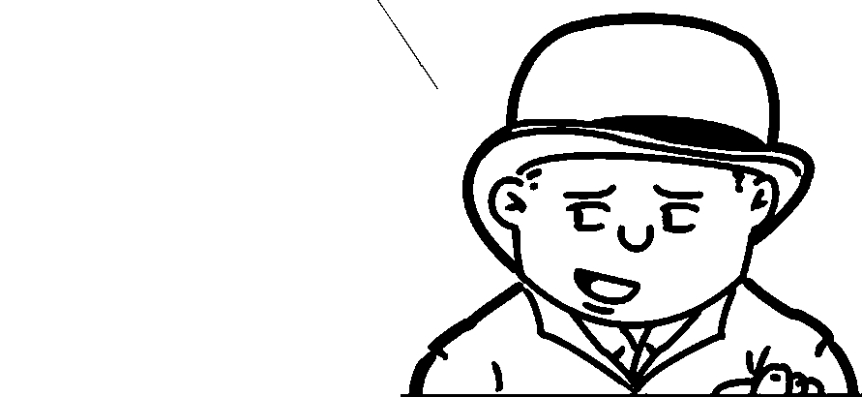
AFTER OUR INVOLVEMENT IN “SCANDAL” AND “FRECKLES”, IT WOULD BE NICE TO HAVE A NICE, QUIET ADVENTURE FOR YOU TO SOLVE.

Slide 6
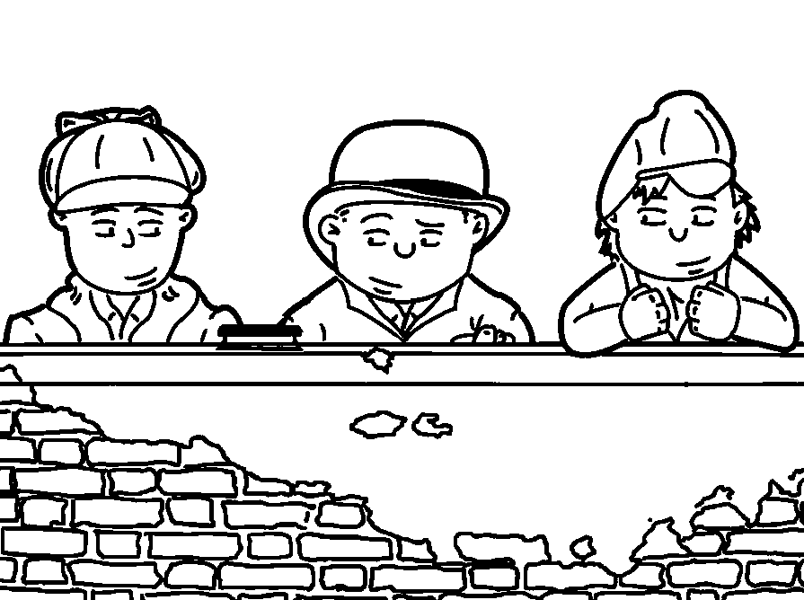

Slide 7
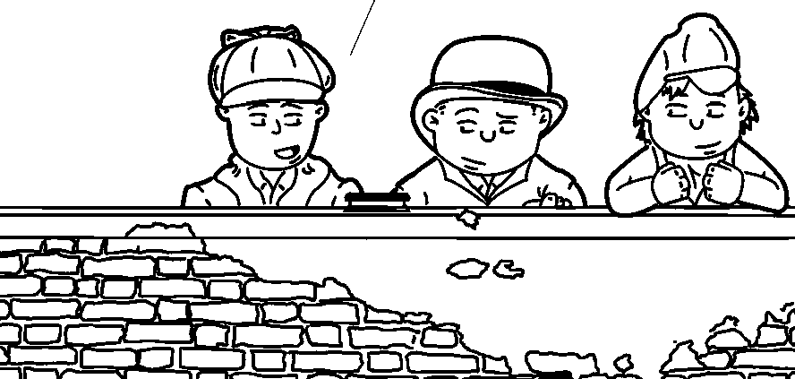
YOU HAVE NOT SEEN THIS… A LITTLE SOUVENIR FROM MASTER ORMSTEIN FOR RETRIEVING THE ADLER DRAWING.

Slide 8
WHAT IS THE ADDICTION FOR TODAY, CHOCOLATE OR TOFFEE?
I HAVE FOUND A NEW DRUG OF CHOICE… JELLYBEANS.

Slide 9
BACK TO YOUR EARLIER OBSERVATION, I HAVE FOUND THE LARGER CRIMES TEND TO BE SIMPLER, AS THE MOTIVE IS MORE OBVIOUS.
AND YOUR FEE IS LARGER.

Slide 10
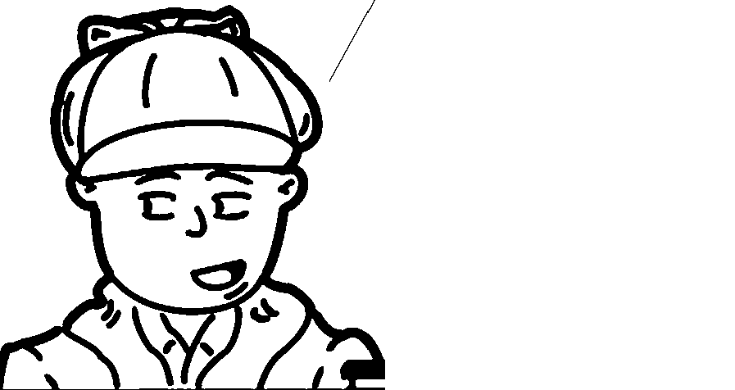
NONETHELESS, UNLESS I AM MISTAKEN THE YOUNG LADY CROSSING THE PLAYGROUND IS MY NEWEST CLIENT.

Slide 11
I HAVE SEEN THESE SYMPTOMS BEFORE… THE FIDGETING MEANS AN AFFAIRE DE COEUR.
ENGLISH PLEASE…

Slide 12
AN AFFAIR OF THE HEART.
THE FIDGETING COULD MEAN SHE IS HESITATING ON WHETHER TO APPROACH, WITH STAMFORD AND I ACCOMPANYING YOU… OR POSSIBLY FLEAS.

Slide 13
WE WILL SOON FIND OUT, BUT IT APPEARS SHE IS MORE PERPLEXED, NOT SO ANGRY.
PROBABLY PERPLEXED ON WHY SHE IS AT AN ALL-BOY’S SCHOOL..

Slide 14
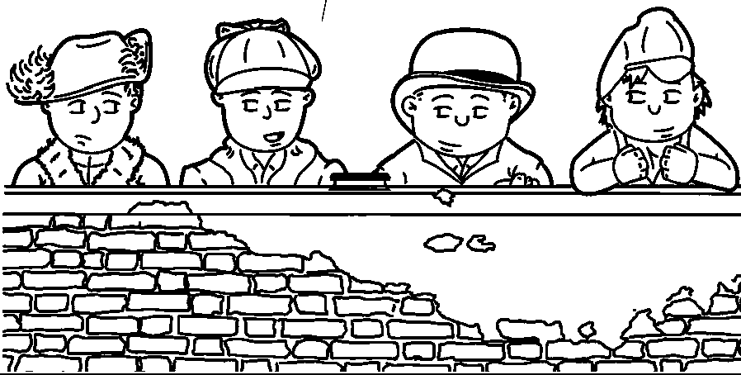
DO YOU NOT FIND YOUR SHORT-SIGHTEDNESS A LITTLE TRYING TO DO SO MUCH DRAWING?

Slide 15
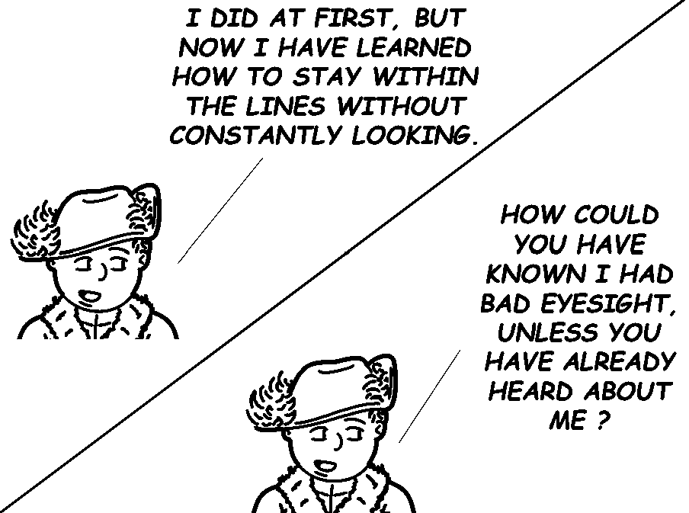
I DID AT FIRST, BUT NOW I HAVE LEARNED HOW TO STAY WITHIN THE LINES WITHOUT CONSTANTLY LOOKING.
HOW COULD YOU HAVE KNOWN I HAD BAD EYESIGHT, UNLESS YOU HAVE ALREADY HEARD ABOUT ME?

Slide 17
MAYBE YOUR CHAPEAU CHOICE? BUT I BELIEVE IT’S A SIMPLE PARLOUR TRICK.
IT’S EFFECTIVE IN NETTING THE CLIENT.

Slide 18
YES, TELL US HOLMES, HOW DID YOU KNOW?
CUT THE SARCASM… IT WAS SIMPLE… WAX BUILDUP UNDER THE FINGERNAILS FROM THE CRAYONS.

Slide 19
WHAT ABOUT THE PAIR OF GLASSES PROTRUDING OUT OF HER COAT POCKET?
THAT TOO. I HAVE TRAINED MYSELF TO SEE WHAT OTHERS OVERLOOK. WHY WOULD YOU HAVE COME FOR MY HELP?

Slide 20
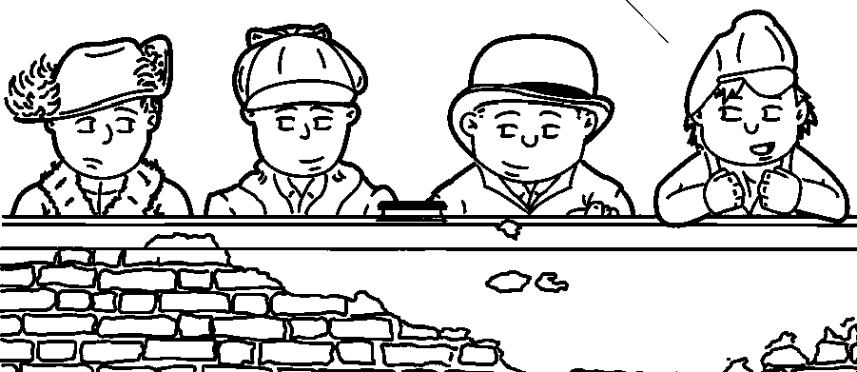
NOT TRAINED WELL ENOUGH TO NOTICE WHEN YOU MISS A BUTTON ON YOUR SHIRT, I OBSERVE.

Slide 21
MY NAME IS MARY SUTHERLAND, AND I ATTEND GREY COAT HOSPITAL DOWN THE ROAD FROM YOUR OWN INSTITUTION HERE.
I CAME TO YOU BECAUSE I HEARD YOU HELPED MS. VIOLET ETHERGE FIND HER LOST CHINA DOLL… SHERLOCK, I’M NOT RICH, BUT I HAVE SET ASIDE A LITTLE FROM MY PARENT’S ALLOWANCE, AS WELL AS THE LITTLE I GET FROM SELLING MY DRAWINGS.

Slide 22
THERE’S A MARKET FOR CRAYON DRAWINGS?
PLAYGROUND PORTRAITS ARE VERY POPULAR AT MY SCHOOL.

Slide 23
CUTE GIRL AND MONEY TO PAY YOU… WE SHOULD TAKE THIS CASE.
SETTLE DOWN CASANOVA.

Slide 24
HOW MUCH FOR A SILHOUETTE?
CAN WE GET BACK TO THE POINT OF MARY’S PLEA FOR MY ASSISTANCE?

Slide 25
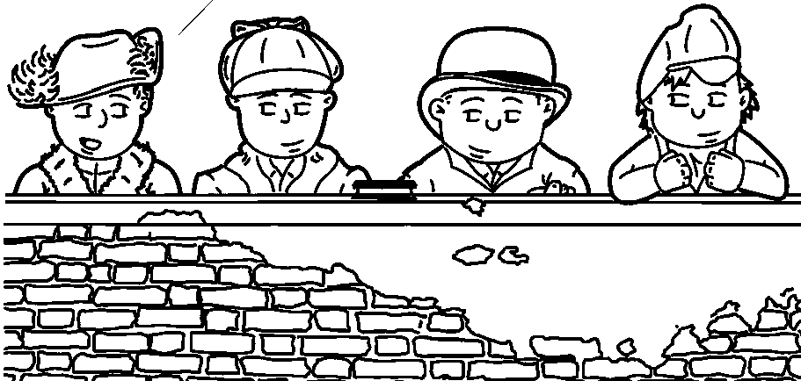
I HAVE NOT PLED FOR ANYTHING YET… BUT YES, I WOULD GIVE ALL MY PLAYGROUND BUTTONS TO KNOW WHAT HAS BECOME OF HOSMER ANGEL.

Slide 26
WHY DID YOU COME FROM SCHOOL IN SUCH A HURRY?
STOP SHOWING OFF!

Slide 27
YES, I DID STORM OFF OF MY OWN PLAYGROUND RATHER QUICKLY… IT MADE ME ANGRY TO SEE THE WAY MY BROTHER, JAMES WINDIBANK, HAS DISMISSED MY CONCERNS.

Slide 28
INTERESTING, HE HAS THE SAME GIVEN NAME AS ME.
WHAT?
NOTHING… PROBABLY WON’T BE IMPORTANT FOR YEARS.

Slide 29
YOUR BROTHER, YOUR STEP-BROTHER SURELY, SINCE THE NAME IS DIFFERENT.

Slide 30
YES, MY STEP-BROTHER… I CALL HIM BROTHER, AS HE HAS BEEN WITH US FOR OVER FIVE YEARS… MY PARENTS AGREED TO TAKE HIM UNDER A WARDSHIP AFTER HIS PARENTS ABANDONED HIM AND WENT TO AMERICA.
MY BROTHER ATTENDS YOUR SCHOOL… I BELIEVE HE IS A YEAR BEHIND YOU, MASTER HOLMES.

Slide 31
YOU HAVE MADE YOUR POSITION VERY CLEAR TO ME… THIS IS MY FRIEND, MASTER WATSON, BEFORE WHOM YOU CAN SPEAK AS FREELY AS BEFORE MYSELF.

Slide 32
WHAT ABOUT THE OTHER?
HE’S MOSTLY HARMLESS.

Slide 33
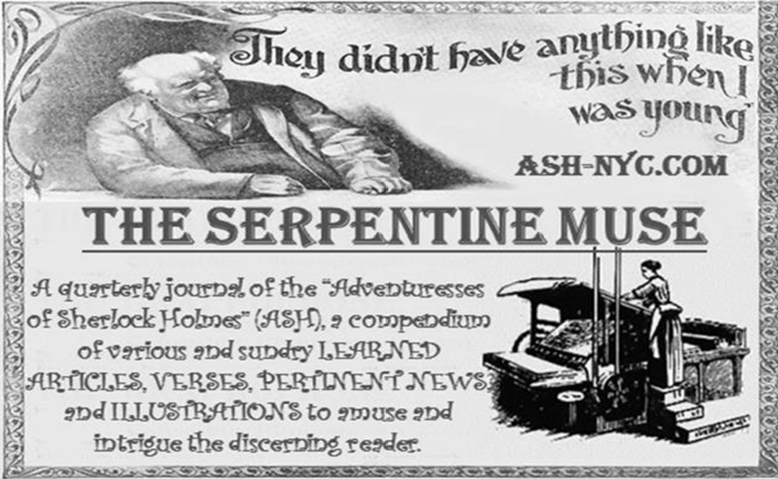

Slide 34
TO CONTINUE MY STORY… I HAVE TWO UNCLES, RICHARD AND GEORGE, WHO TOOK OVER THE FAMILY BUSINESS A FEW YEARS AGO.

Slide 35
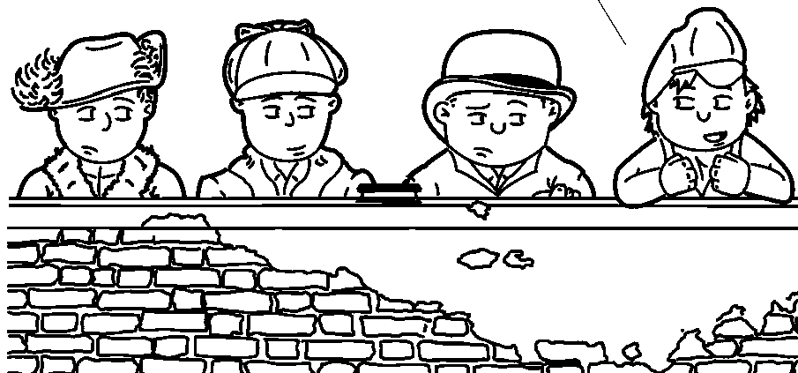
WAIT… RICHARD… GEORGE… IS THEIR LAST NAME CADBURY?

Slide 36
WHY, YES, IT IS… THEY ARE MY MOTHER’S BROTHERS.
I BELIEVE I AM IN LOVE WITH YOU.

Slide 37
SETTLE DOWN, STAMFORD… PRAY PROCEED, MISS SUTHERLAND.

Slide 38
YES, MY FAMILY ARE CONFECTIONERS OF CHOCOLATE DELIGHTS… SINCE MY UNCLES HAVE TAKEN OVER, THEY HAVE WORKED HARD TO IMPROVE THE PRODUCT LINE.

Slide 39
RECENTLY, THEY HAVE BEEN WORKING ON A NEW PROCESS OF EXTRACTING COCOA WHICH WILL BE LESS BITTER, THUS MAKING THEIR CHOCOLATE SWEETER THAN THE COMPETITION.

Slide 40
THEY ASKED JAMES AND I, THEIR FAVORITE NEPHEW AND NIECE, TO HELP WITH TASTE TESTING OF THE NEW PRODUCT.
I KNOW I AM IN LOVE WITH YOU.

Slide 41
EACH WEEK, JAMES AND I RECEIVE A PACKAGE OF EXPERIMENTAL PRODUCTS TO TASTE-TEST… AS YOU CAN IMAGINE, ONE CAN ONLY CONSUME SO MUCH CHOCOLATE… MOST WEEKS, I GIVE ALMOST ALL OF MY SHARE TO MY BROTHER.
GIVE AWAY CHOCOLATE… OH, THE HORRORS!

Slide 42
LET’S MOVE ON TO YOUR CONNECTION TO THIS MASTER ANGEL.
I’M HUNGRY… DID YOU HAPPEN TO BRING ANY SAMPLES WITH YOU?

Slide 43
I MET MASTER ANGEL AT A SOCIAL DANCE A FEW WEEKS AGO, HOSTED BY MY GRANDPARENTS… FOR SOME REASON, MY BROTHER WAS AGAINST MY ATTENDING.

Slide 44
JAMES SAID I HAD NOTHING TO WEAR, WHEN I HAD MY PURPLE PLUSH THAT I HAD NEVER SO MUCH AS TAKEN OUT OF THE DRAWER… AT LAST, WHEN NOTHING ELSE WOULD DO, HE WENT OFF TO SPEND THE WEEKEND WITH OUR COUSINS.

Slide 45
I SUPPOSE WHEN MASTER WINDIBANK RETURNED, HE WAS VERY ANNOYED AT YOUR ATTENDANCE AT THE DANCE.

Slide 46
HE WAS VERY GOOD ABOUT IT… HE LAUGHED AND SHRUGGED HIS SHOULDERS, AND SAID THERE WAS NO USE DENYING ANYTHING TO A WOMAN.
A BOY WISE BEYOND HIS YEARS.

Slide 47
MASTER ANGEL CALLED ON ME THE NEXT DAY, AND SEVERAL DAYS AFTER THAT… I QUICKLY RECOGNIZED HE WAS NOT A BOY OF MEANS.
HE FINALLY ADMITTED HIS PARENTS ARE STRUGGLING TO GET BY, WITH NO OPPORTUNITY TO OFFER HIM ANY OF THE FINER THINGS OF VICTORIAN LIFE.

Slide 48
WITHOUT MY PITY SHOWING TOO OBVIOUSLY, I HAVE STARTED SUPPLYING HIM SHARES OF MY CHOCOLATES RECEIVED EACH WEEK, SPLITTING OUR WEEKLY ALLOTMENT FROM TWO TO THREE.
WOULD YOU CONSIDER FOUR SHARES PER WEEK?

Slide 49
HOW HAS YOUR BROTHER REACTED TO THIS ACT OF BENEVOLENCE ON YOUR PART?
YOU GIVE AWAY CANDY I COULD HAVE, I WOULD NOT REACT WELL.

Slide 50
JAMES HAS ACTED LIKE HE DOES NOT NOTICE, BUT I AM SURE HE MUST RECOGNIZE THE LESSER SHARE, AS HE IS A GLUTTON FOR THE SWEETS.

Slide 52
HE HAS CHOSEN TO VISIT OUR COUSINS EACH WEEKEND, ALLOWING HOSMER AND I TO RENDEZVOUS EACH WEEK… DURING THE WEEK, HOSMER AND I EXCHANGE NOTES EACH DAY THROUGH SEVERAL CONFEDERATES AT EACH SCHOOL.

Slide 53
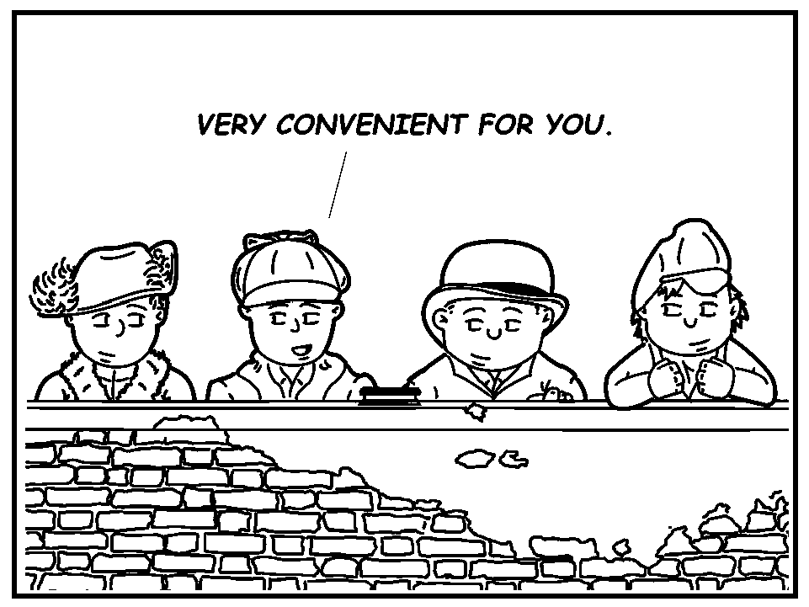
VERY CONVENIENT FOR YOU.

Slide 54
HAVE YOU BECOME ENGAGED TO THIS FELLOW?
NOT HARDLY… I’M NOT EVEN A TEENAGER YET… NOT EVEN A GOODNIGHT KISS… MASTER ANGEL IS VERY SHY AND IS RELUCTANT TO HOLD MY HAND.

Slide 55
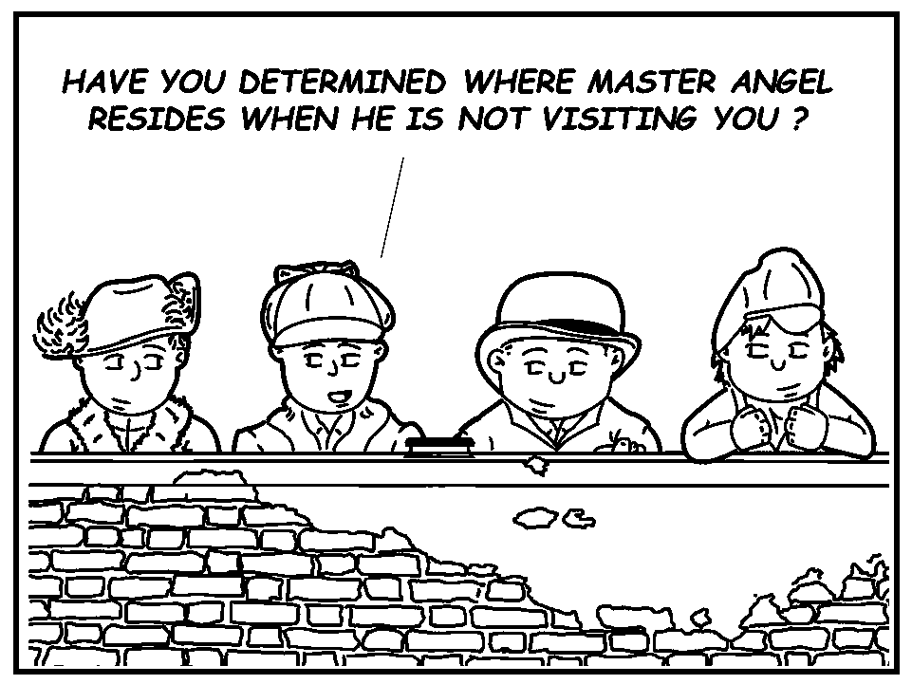
HAVE YOU DETERMINED WHERE MASTER ANGEL RESIDES WHEN HE IS NOT VISITING YOU?

Slide 56
NO… FOR CONVENIENCE, MY LETTERS ARE DELIVERED TO YOUR SCHOOL, TO BE PLACED IN THE GENERAL POSTAL BOX… MASTER ANGEL THEN PICKS THEM UP FROM THE OFFICE.

Slide 57
HE IS SO SWEET, HE USES SHARPENED CRAYONS TO WRITE HIS NOTES, JUST AS I DO… THAT WILL SHOW YOU HOW FOND HE WAS OF ME, MASTER HOLMES, AND THE LITTLE THINGS THAT HE WOULD THINK OF, SUCH AS DRAWING LITTLE HEARTS AROUND MY NAME.

Slide 58
THAT IS MOST SUGGESTIVE.
SUGGESTIVE OF A ‘NUT’, AND NOT THE TYPE YOU FIND IN CANDY.

Slide 59
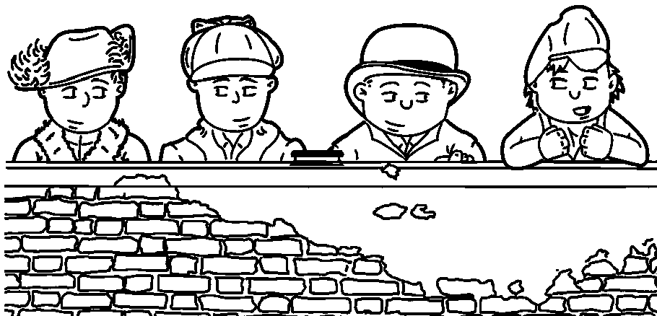
IT SUGGESTS I MAY GET NAUSEOUS.

Slide 60
IT HAS LONG BEEN AN AXIOM OF MINE THAT THE LITTLE THINGS ARE INFINITELY THE MOST IMPORTANT… CAN YOU REMEMBER ANY OTHER LITTLE THINGS ABOUT MASTER HOSMER ANGEL?

Slide 61
HE WAS A RATHER SHY LAD… HE WOULD RATHER WALK WITH ME IN THE EVENING THAN IN THE DAYLIGHT, FOR HE SAID HE HATED TO BE CONSPICUOUS.
HE WAS ALWAYS WELL DRESSED, VERY NEAT AND PLAIN, BUT HIS EYES WERE WEAK, JUST AS MINE ARE, AND HE WORE TINTED GLASSES AGAINST THE GLARE.

Slide 62
MASTER ANGEL CAME TO MY HOUSE TWO WEEKENDS AGO AND PROPOSED WE SHOULD BE PLEDGED TO EACH OTHER UNTIL WE BOTH MATRICULATE FROM SCHOOL… HE MADE ME SWEAR, WITH MY HAND ON A DICKEN’S CHRISTMAS CAROL, I WOULD ALWAYS BE TRUE TO HIM.
WE WERE TO ATTEND THE CHRISTMAS DANCE TOGETHER LAST FRIDAY AT THE ASSEMBLY ROOMS AT KING STREET… SOON AFTER ARRIVING, HOSMER EXCUSED HIMSELF TO VISIT ‘THE LITTLE BOY’S ROOM’.

Slide 63
THE WHAT?
THE PRIVY.
OH… NEVER MIND.

Slide 64
AFTER WAITING FOR A SUBSTANTIAL TIME, I ASKED VERY POLITELY FOR ONE OF THE MALE CHAPERONES TO CHECK THE CLOSET.
YOU CAN IMAGINE MY SURPRISE WHEN HE ANNOUNCED THE ROOM WAS EMPTY… THE CHAPERONE SAID HE COULD NOT IMAGINE WHAT HAD BECOME OF HOSMER, AS HE HAD SEEN MY BEAU ENTER THE ROOM.

Slide 65
SHERLOCK, DIDN’T YOU SOLVE A CASE WHERE A GENTLEMAN STEPPED BACK INTO HIS OWN HOUSE TO GET HIS UMBRELLA, AND WAS NEVER SEEN IN THIS WORLD AGAIN?
NOT YET, I HAVEN’T.

Slide 66
THE DISAPPEARANCE OCCURRED LAST FRIDAY, MASTER HOLMES, AND I HAVE NOT SEEN OR HEARD ANYTHING SINCE THEN TO THROW ANY LIGHT UPON WHAT BECAME OF HIM.

Slide 67
IT SEEMS TO ME YOU HAVE BEEN VERY SHAMEFULLY TREATED.

Slide 68
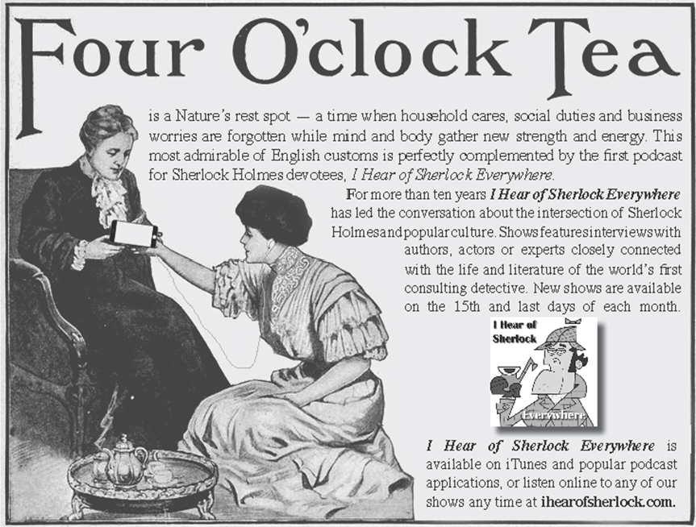

Slide 69
OH NO! THAT I CANNOT ACCEPT… ALL THAT WEEK HE WAS SAYING TO ME WHATEVER MAY HAPPEN, I WAS TO BE TRUE… I WAS ALWAYS TO REMEMBER I WAS PLEDGED TO HIM.
I MUST ADMIT IT SEEMED A LITTLE STRANGE TALK FOR ONE SO YOUNG, BUT HIS PLEDGE SEEMS PROPHETIC NOW.

Slide 70
MOST CERTAINLY IT DOES… YOUR OWN OPINION IS SOME UNFORESEEN CATASTROPHE HAS OCCURRED TO HIM?

Slide 71
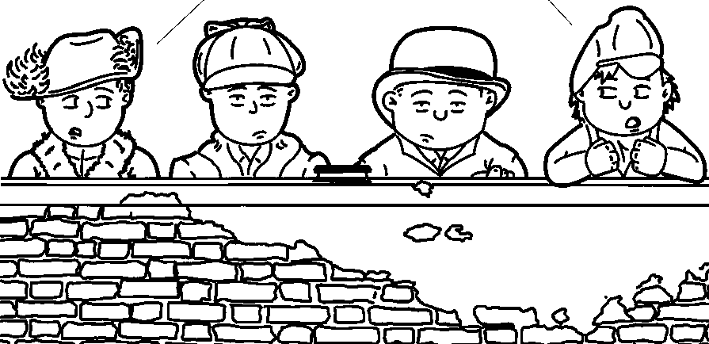
COULD HE HAVE BEEN ABDUCTED BY MARTIANS?
WHO? OR WHAT?

Slide 72
ONE OF OUR FRIENDS, HERBERT GEORGE, HAS SOME VERY INTERESTING IDEAS ABOUT LIFE ON OTHER PLANETS… I DON’T BELIEVE THIS IS A VERY PLAUSIBLE THEORY.

Slide 73
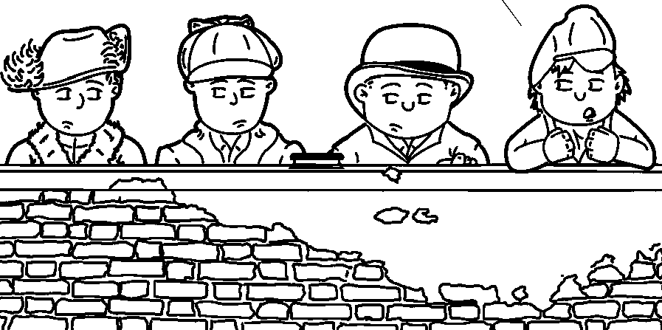
I DON’T KNOW… MIGHT EXPLAIN HOW HE DISAPPEARED FROM THE PRIVY WITHOUT A TRACE.

Slide 74
YOU ARE A STRANGE LITTLE BOY.
WE’RE GOING TO HAVE HIM TESTED.

Slide 75
SO HOW DID JAMES TAKE THE MATTER?
HE SIDED WITH ME, THAT SOMETHING HAS HAPPENED, AND I SHOULD HEAR FROM HOSMER AGAIN.

Slide 76
MAYBE HE COULD NOT HANDLE YOUR MORE AFFLUENT LIFESTYLE?
WHILE HOSMER WAS POOR, HE WAS VERY INDEPENDENT AND NEVER WOULD TAKE A SHILLING OF MINE… HE WOULD ONLY ACCEPT THE CHOCOLATES I PROVIDED HIM EACH WEEK.

Slide 77
OH, IT DRIVES ME HALF-MAD… HE WAS SO SWEET.
I MIGHT SUGGEST YOU QUIT MENTIONING HIM IN THE PAST TENSE.

Slide 78
I SHALL GLANCE INTO THE CASE FOR YOU… AND I HAVE NO DOUBT WE SHALL REACH SOME DEFINITE RESULT.

Slide 79
LET THE WEIGHT OF THE MATTER REST UPON ME NOW, AND DO NOT LET YOUR MIND DWELL UPON IT… ABOVE ALL, TRY TO LET HOSMER ANGEL VANISH FROM YOUR MEMORY, AS HE HAS DONE FROM YOUR LIFE.

Slide 81
THEN YOU DON’T THINK I SHALL SEE HIM AGAIN?
I FEAR NOT.

Slide 82
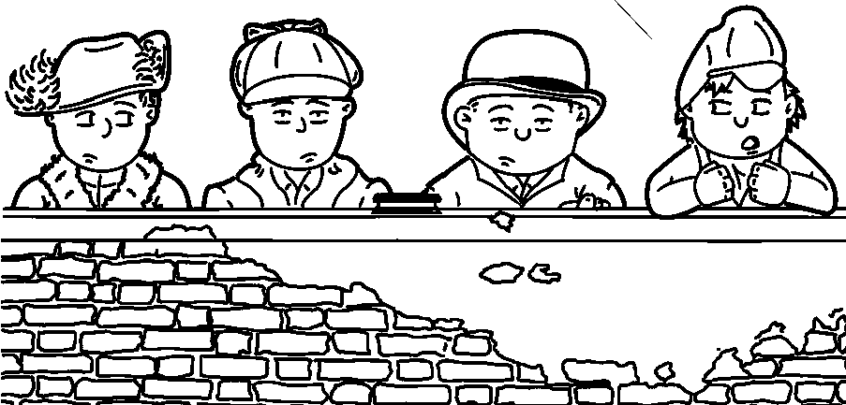
UNLESS THE MARTIANS RETURN HIM AFTER THEY ARE FINISHED EXPERIMENTING ON HIM.

Slide 83
GIVE IT A REST.
YOU KNOW MY PARENTS HAVE HAD ME TESTED.

Slide 84
WHAT DO YOU BELIEVE HAS HAPPENED TO HIM, MASTER HOLMES?
LEAVE THAT TO ME TO DETERMINE… PLEASE LEAVE ME ANY LETTERS OF HIS YOU CAN SPARE, AS WELL AS AN ACCURATE DESCRIPTION OF HIM.

Slide 85
I ADVERTISED FOR HIM IN BOTH SCHOOL PAPERS LAST SATURDAY… HERE ARE FOUR LETTERS FROM HIM, AS WELL AS THE NEWSPAPER CLIPPINGS.
YOU HAVE MADE YOUR STATEMENT VERY CLEARLY… PLEASE REMEMBER THE ADVICE I HAVE GIVEN YOU… LET THE WHOLE INCIDENT BE A SEALED BOOK, AND DO NOT ALLOW IT TO AFFECT YOUR LIFE.

Slide 86
YOU ARE VERY KIND, MASTER HOLMES, BUT I CANNOT DO THAT… I SHALL BE TRUE TO HOSMER… HE SHALL FIND ME READY TO REINSTATE OUR COURTSHIP WHEN HE COMES BACK.

Slide 87
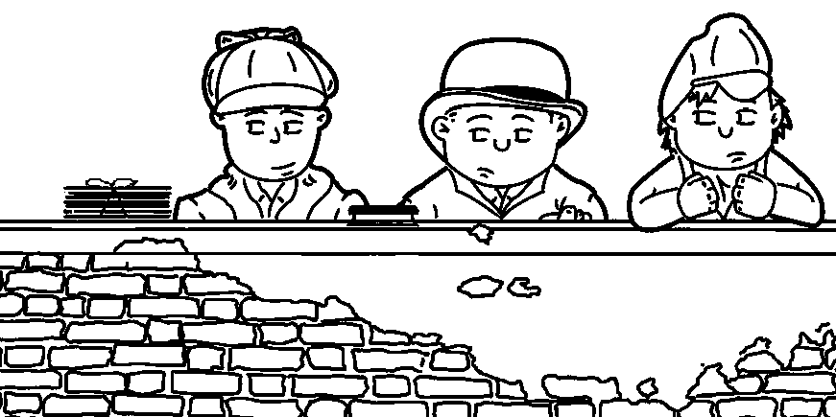

Slide 88
QUITE AN INTERESTING STUDY, THAT YOUNG LADY… SHE IS MORE INTERESTING THAN HER LITTLE PROBLEM, WHICH IS RATHER A TRITE ONE… BEFORE MY CAREER IS OVER, I BELIEVE I WILL SOLVE MANY PARALLEL CASES.
FORTUNATELY, THERE ARE ONE OR TWO SINGULAR DETAILS NEW TO ME FOR THIS CASE.

Slide 89
YOU APPEARED TO READ A GOOD DEAL UPON HER WHICH WAS QUITE INVISIBLE TO ME.
I STILL LIKE MY MARTIAN IDEA.

Slide 90
NOT INVISIBLE, BUT UNNOTICED, WATSON… I CAN NEVER BRING YOU TO REALIZE THE IMPORTANCE OF A PERSON’S APPEARANCE… DESCRIBE HER APPEARANCE.

Slide 91
SHE HAD A STRAW HAT ON, DARK JACKET, BROWN DRESS, PURPLE PLUSH ON THE SLEEVES, GRAYISH GLOVES.
SHE ALSO HAD VERY SMALL GOLD EARRINGS.

Slide 92
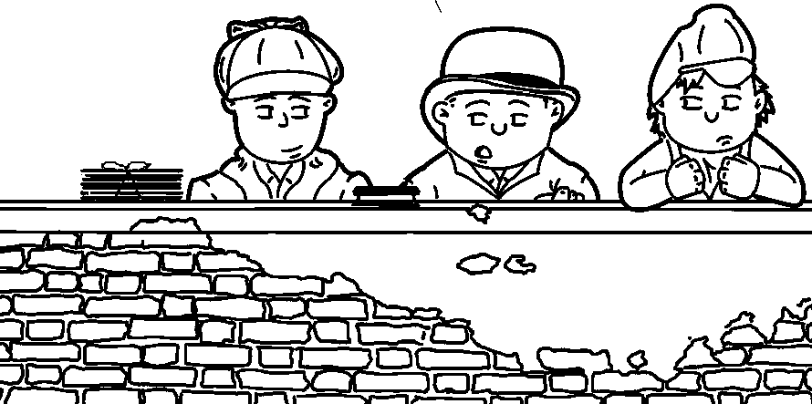
SHE HAD A GENERAL AIR OF BEING WELL-TO-DO IN AN EASY-GOING MANNER.

Slide 94
‘PON MY WORD, WATSON, YOU ARE COMING ALONG NICELY.
WHAT ABOUT ME, I SPOTTED THE EARRINGS.

Slide 95
BOTH OF YOU HAVE DONE VERY WELL INDEED… IT IS TRUE YOU MISSED EVERYTHING OF IMPORTANCE.
YOUR COMPLIMENTS LEAVE MUCH TO BE DESIRED.

Slide 96
NEVER TRUST TO GENERAL IMPRESSIONS, CONCENTRATE UPON DETAILS… THE DOUBLE LINE ON THE PLUSH JUST ABOVE THE WRIST WAS WELL-DEFINED, WHERE AN ILLUSTRATOR PRESSES AGAINST THE TABLE.
I ALSO NOTICED THE DINT OF A PINCE-NEZ AT EITHER SIDE OF HER NOSE, WHICH INDICATES SHORT-SIGHT.

Slide 97
THE BOOTS WERE DIFFERENT, ONE WITH A DECORATED TOE-CAP, THE OTHER PLAIN, INDICATING A RUSH IN GETTING DRESSED.
WOULD YOU MIND READING ME THE ADVERTISED DESCRIPTION OF MASTER HOSMER ANGEL?

Slide 98
AS BEFORE, IS THERE SOMETHING WRONG WITH YOUR EYES?
STAMFORD, PLEASE HUMOUR ME… WATSON FORGETS WHO SOMEDAY MAY BE BUTTERING HIS BREAD.

Slide 99
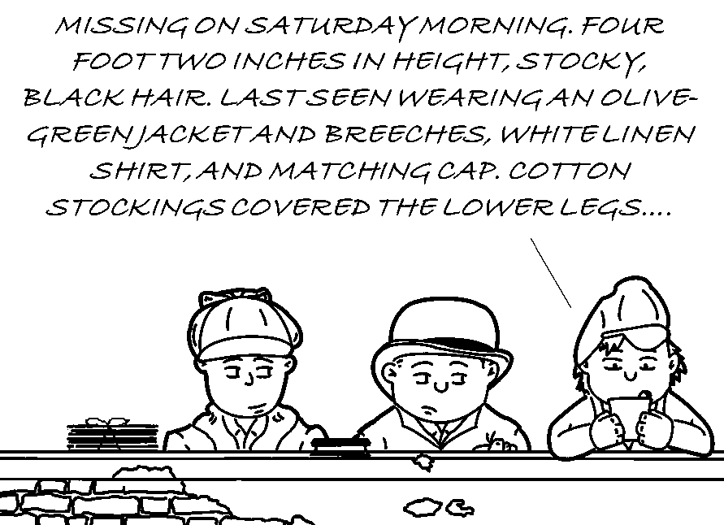

Slide 100
THAT WILL DO… AS TO THE NOTES, I WILL NOT BE SURPRISED IF THEY ARE VERY COMMONPLACE.
YES, I FREQUENTLY WRITE NOTES USING SHARPENED CRAYONS.

Slide 101
THAT WAS NOT THE POINT I WAS ATTEMPTING TO MAKE… HOWEVER, I SHALL WRITE A NOTE TO MASTER WINDIBANK ASKING WHETHER HE COULD MEET US HERE TOMORROW AFTERNOON AFTER SCHOOL… UNTIL THEN, I SUGGEST WE FOCUS ON OUR SCHOOL WORK.

Slide 103
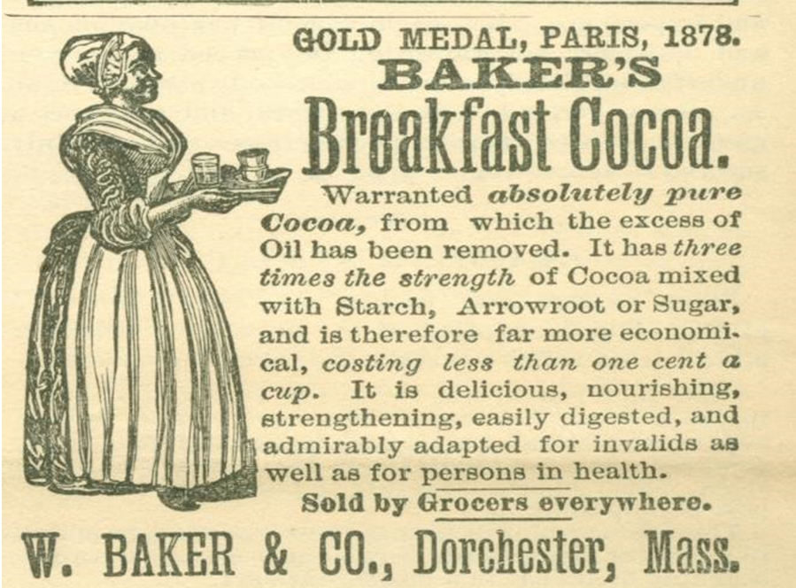

Slide 104
WELL, HAVE YOU SOLVED IT?
YES, IT WAS THE SULPHATE OF BARYTA.

Slide 105
YOU KNOW ONE OF MY AXIOMS: IF YOU CAN’T HELIUM OR CURIUM, YOU BARIUM.
ARE THOSE ALL FAMOUS SCIENTISTS?

Slide 106
I DON’T GET IT AT ALL.
NEITHER DID OSMIUM, BUT IT’S RATHER DENSE.

Slide 107
NO, NO, THE DISAPPEARANCE MYSTERY!!
OH THAT… NEVER WAS A MYSTERY, THOUGH SOME OF THE DETAILS ARE OF INTEREST… I FEAR THERE IS NO LAW THAT CAN TOUCH THE SCOUNDREL.

Slide 108
AS I SURMISED, THERE WAS NO CLUE IN THE NOTES FROM MASTER ANGEL, SAVE HE QUOTES ‘MOTHER GOOSE’ ONCE… THERE IS ONE REMARKABLE POINT, HOWEVER, WHICH WILL NO DOUBT STRIKE YOU.
NO DOUBT?

Slide 109
THE SIGNATURE IS SIMPLY AN 11X 11 AT THE BOTTOM OF EACH NOTE, IN LIEU OF HIS FULL NAME, OR EVEN A PET NAME… THIS POINT IS VERY SUGGESTIVE… IN FACT, WE MAY CALL IT CONCLUSIVE.

Slide 110
I CANNOT SAY I SEE HOW THIS PROVES ANYTHING, UNLESS HOSMER WISHED TO BE ABLE TO DENY HIS SIGNATURE IF AN ACTION FOR BREACH OF PROMISE WERE INSTITUTED.

Slide 111
UNLIKELY, SINCE CHILDREN OF MINOR AGE ARE NOT HELD RESPONSIBLE FOR CONTRACTUAL ISSUES… SADLY, YOU ARE STILL MISSING THE POINT.

Slide 112
MAYBE HOSMER IS A MARTIAN AND COULD NOT SPELL HIS ASSUMED NAME.
I LIKED IT BETTER WHEN
YOU JUST APPEARED IN THE FIRST SCENE OF A STORY.

Slide 113
WHO WAS MASTER ANGEL, AND WHAT WAS HIS OBJECT IN DESERTING MS. SUTHERLAND?
IT’S STILL MISS… YEARS TO COME.

Slide 114
I BELIEVE THIS MAY ANSWER YOUR QUERY.

Slide 115
WELCOME, MASTER WINDIBANK… I BELIEVE THIS CRAYON-WRITTEN NOTE IS FROM YOU, RESPONDING TO MY INVITATION?

Slide 116
YES IT IS… I AM SORRY MY SISTER HAS TROUBLED YOU ABOUT THIS LITTLE MATTER, FOR I THINK IT IS FAR BETTER NOT TO WASH LINEN OF THIS SORT IN PUBLIC.
WHAT DOES LAUNDERING YOUR UNDERGARMENTS HAVE TO DO WITH THIS?

Slide 117
MY SISTER MENTIONED THE QUIRKY ONE - MUST BE YOU… IT IS NOT PLEASANT TO HAVE A FAMILY MISFORTUNE LIKE THIS NOISED ABOUT, EVEN BY SOMEONE UNOFFICIAL AS YOU, MASTER HOLMES… BESIDES, HOW COULD YOU POSSIBLY FIND THIS HOSMER ANGEL?

Slide 118
ON THE CONTRARY, I HAVE EVERY REASON TO BELIEVE I WILL SUCCEED IN DISCOVERING MASTER HOSMER ANGEL.
I AM DELIGHTED TO HEAR IT.

Slide 119
IT IS A CURIOUS THING, A CRAYON HAS REALLY AS MUCH INDIVIDUALITY AS A TYPEWRITER.
WHILE THERE ARE SEVERAL BRANDS ON THE MARKET, ONE OR TWO STAND OUT DUE TO THEIR QUALITY AND TINTS… OFFENHEIM & ZIFFER CRAYONS HAVE A VERY DISTINCTIVE SKY-BLUE COLOR THAT NO OTHER COMPANIES HAVE BEEN ABLE TO REPRODUCE.

Slide 121
YOU MAY NOTICE YOUR RESPONSE NOTE BACK TO ME IS INDICATIVE OF THAT PECULIAR COLOUR… ADDITIONALLY, I NOTE YOUR ‘E’ HAS A LONGER TAIL THAN NORMAL, AND THE TALE OF YOUR ‘Y’ HAS A CURLY TAIL SUCH AS A YOUNG PIGLET.

Slide 122
THERE ARE FOURTEEN OTHER CHARACTERISTICS, BUT THOSE ARE THE MOST OBVIOUS.
I ASSUME WE ALL HAVE OUR OWN INDIVIDUAL PECULIARITIES.

Slide 123
YES, WE DO… AND NOW I WILL SHOW YOU WHAT IS REALLY A VERY INTERESTING STUDY… I THINK OF WRITING A LITTLE MONOGRAPH SOME DAY ON CRAYONS AND THEIR RELATION TO CRIME… I BELIEVE I CAN IDENTIFY THE VARIOUS CRAYONS BASED ON THEIR WAX RESIDUE AND DUST WHEN BEING SHARPENED.

Slide 124
I PLAN ON CONDUCTING A SIMILAR STUDY ON TOBACCO ASH, ONCE I AM OLD ENOUGH TO SEE OVER THE COUNTER AT THE TOBACCONIST SHOP TO PURCHASE THE EVIDENCE I NEED.
THUS, A NEW ADDICTION BEGINS.

Slide 125
HERE'S THE FASCINATING PART… I HAVE HERE FOUR NOTES WHICH PURPORT TO COME FROM THE MISSING MAN… THEY ARE ALL WRITTEN IN CRAYON, SUCH AS YOUR NOTE.
IN EACH CASE, NOT ONLY ARE THE ‘E’S’ ELONGATED AND THE ‘R'S’ CURLED, ALL FIVE NOTES ARE WRITTEN WITH THE SAME BRAND OF SKY-BLUE CRAYON… IF YOU CARE TO USE MY MAGNIFYING LENS, YOU MAY OBSERVE THE OTHER FOURTEEN CHARACTERISTICS I ALLUDED TO.

Slide 126
I CANNOT WASTE TIME OVER THIS SORT OF FANTASTIC TALK, MASTER HOLMES… IF YOU CATCH THE LAD, BE DONE WITH IT, AND LET ME KNOW WHEN YOU HAVE DONE IT.

Slide 127
CERTAINLY… I LET YOU KNOW, THEN I HAVE CAUGHT HIM!!
WHAT??
WHERE??

Slide 128
OH, IT WON’T DO… REALLY IT WON’T… THERE IS NO POSSIBLE GETTING OUT OF IT, MASTER WINDIBANK… IT WAS A BAD COMPLIMENT WHEN YOU SAID IT WAS IMPOSSIBLE FOR ME TO SOLVE SO SIMPLE A QUESTION… LET US TALK IT OVER.

Slide 129
IT’S NOT ACTIONABLE.
I AM VERY MUCH AFRAID IT IS NOT… BUT IT WAS AS CRUEL AND SELFISH HEARTLESS A TRICK AS EVER CAME BEFORE ME… LET ME RUN OVER THE COURSE OF EVENTS, AND YOU CONTRADICT ME IF I GO WRONG.

Slide 130
THE BOY AND HIS SISTER BECAME THE VERY LUCKY BENEFICIARIES OF LOVING UNCLES, WHO SUPPLIED THEM WITH ALL THE TREATS THEY COULD POSSIBLY DREAM OF… SOON, THE BOY BECAME SO ENAMORED WITH THE CHOCOLATES, HE COULD NOT STAND THE IDEA OF HIS SISTER SHARING THEIR TREASURES WITH OTHERS.
OF COURSE, HE REALIZED HIS SISTER, BEING THE GIVING TYPE, WOULD BE MORE THAN WILLING TO PROVIDE THE SWEETS WITH THOSE LESS FORTUNATE… ANY FUTURE DATING AND COURTSHIP COULD CUT SEVERELY INTO HIS WEEKLY HOARD OF CHOCOLATES.

Slide 131
SOON, HIS SISTER BECOMES RESTIVE, WANTING TO SOCIALIZE, AS MOST YOUNG GIRLS ARE WANT… WHAT DOES THE CLEVER STEP-BROTHER DO… HE CONCEIVES AN IDEA MORE CREDITABLE TO HIS HEAD THAN TO HIS HEART.
HE DISGUISED HIMSELF, COVERED HIS EYES WITH TINTED GLASSES, WORE A WIG TO CHANGE HAIR COLOUR, AND CHANGED THE TIMBRE OF HIS VOICE… BUOYED BY HIS SISTER’S SHORT-SIGHT, HE APPEARS AT THE SOCIAL AS MASTER HOSMER ANGEL, AND KEEPS OFF OTHER BEAU’S AND CHOCO-HOLICS BY SHOWING INTEREST HIMSELF.

Slide 133
IT WAS ONLY A JOKE AT FIRST… I NEVER THOUGHT SHE WOULD HAVE BEEN SO CARRIED AWAY.

Slide 134
THE YOUNG LASS WAS VERY DECIDEDLY CARRIED AWAY… THE SUSPICION OF TREACHERY NEVER FOR AN INSTANT ENTERED THE MIND OF SUCH AN AMIABLE, LOVING PERSON… SHE WAS FLATTERED BY THE LAD'S ATTENTIONS.
ONCE MASTER ANGEL BEGAN TO CALL, OBVIOUS THE MATTER SHOULD BE PUSHED AS FAR AS IT WOULD GO IF A REAL EFFECT WERE TO BE PRODUCED.

Slide 135
THERE WERE MEETINGS, A PLEDGE, WHICH WOULD FINALLY SECURE THE GIRL’S AFFECTIONS FROM TURNING TOWARDS ANYONE ELSE… BUT THE DECEPTION COULD NOT BE KEPT UP FOREVER… THESE PRETENDED SLEEPOVERS AT THE COUSINS WERE RATHER CUMBROUS.

Slide 136
THE THING TO DO WAS CLEARLY TO BRING THE BUSINESS TO AN END IN SUCH A DRAMATIC MANNER IT WOULD LEAVE A PERMANENT IMPRESSION UPON THE YOUNG LADY'S MIND AND PREVENT HER FROM LOOKING UPON ANY OTHER SUITOR FOR SOME TIME TO COME.
HENCE THOSE VOWS OF FIDELITY EXACTED UPON A SACRED TEXT, AND HENCE ALSO THE ALLUSIONS TO A POSSIBILITY OF SOMETHING HAPPENING.

Slide 137
WINDIBANK WISHED MARY TO BE SO BOUND TO ANGEL, AND SO UNCERTAIN AS TO HIS FATE, THAT UNTIL THE CHOCOLATE SHIPMENTS CAME TO AN END ONCE THE TESTING WAS OVER, SHE WOULD NOT EVEN LOOK AT ANOTHER YOUNG FELLOW… SUCH WAS HIS URGE TO OBTAIN AND CONSUME ALL THE CHOCOLATES RECEIVED BY BOTH HE AND HIS SISTER EACH WEEK.
HE CONVENIENTLY VANISHED AWAY BY THE OLD TRICK OF HIDING ABOVE A CEILING PANEL UNTIL THE PUZZLED MAIDEN LEFT THE BUILDING… I BELIEVE I HAVE COMPLETED THE LINKS TO THE CHAIN OF EVENTS, MASTER WINDIBANK.

Slide 138
STILL LIKE MY MARTIAN IDEA BETTER.

Slide 139
IT MAY BE SO, OR IT MAY NOT, MASTER HOLMES… I ASSUME YOU ARE SHARP ENOUGH TO KNOW I HAVE DONE NOTHING ACTIONABLE FROM THE FIRST, AND ANY ATTEMPT TO HOLD ME WOULD OPEN YOURSELF TO AN ACTION FOR ASSAULT AND ILLEGAL CONSTRAINT.

Slide 140
THE LAW CANNOT TOUCH YOU, YET THERE WAS NEVER A YOUNG LAD WHO DESERVED PUNISHMENT MORE… IF THE YOUNG LADY HAD AN OLDER BROTHER OR A FRIEND, HE OUGHT TO LAY A WHIP ACROSS YOUR SHOULDERS.
BY JOVE, IT IS NOT PART
OF MY DUTIES TO MY CLIENT, BUT AS IGNATIUS’ BAT HAPPENS TO BE HANDY, AND I THINK I SHALL JUST TREAT MYSELF TO…

Slide 142
THAT FELLOW WILL RISE FROM CRIME TO CRIME UNTIL HE DOES SOMETHING VERY BAD AND ENDS UP IN THE DOCK… THE CASE HAS, IN SOME RESPECTS, BEEN NOT ENTIRELY DEVOID OF INTEREST.

Slide 144
AND WHAT OF MISS SUTHERLAND?
IF I TELL HER, SHE WILL NOT BELIEVE ME… YOU MAY REMEMBER THE OLD PERSIAN SAYING, "THERE IS DANGER FOR HIM WHO TAKETH THE TIGER CUB, AND DANGER ALSO FOR WHOSO SNATCHES A DELUSION FROM A WOMAN."

Slide 145
MAYBE HE SHOULD ADOPT THE OLD ADAGE, “SISTERS AND CHOCOLATE MAKE LIFE BEARABLE.”
OR, “IF I HAD 10 CHOCOLATE TREATS, AND A DEAR FRIEND ASKED FOR ONE, HOW MANY WOULD I HAVE LEFT… THAT’S RIGHT… 10!

Slide 146
IT IS INTERESTING YOU SOLVED THIS MYSTERY WITHOUT EVER HAVING TO LEAVE THIS SPOT.
DOESN’T CHANGE HIS FEE.

Slide 147
MAYBE WE SHOULD SPEND THE WEEKEND LOOKING FOR THOSE MARTIANS.

