Slide 2
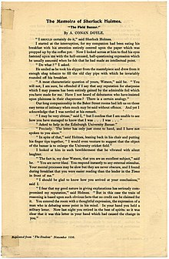

Slide 3
Baker Street Elementary
“The Field Bazaar”
Copyright 2021 © by Joe Fay, Rusty Mason, and Steve Mason
1st Edition
Published in Dallas, Texas
All rights reserved. No part of this book may be reproduced, stored, or transmitted in any form or by any means without prior permission of the authors (which is not that hard to obtain), except for brief excerpts for reviews)

Slide 4
I SHOULD CERTAINLY DO IT, MY DEAR WATSON.
I HAVEN’T A CLUE WHAT YOU ARE TALKING ABOUT.

Slide 5
A MOST CHARACTERISTIC QUESTION OF YOURS, WATSON… YOU WILLL NOT, I AM SURE, BE OFFENDED IF I SAY THAT ANY REPUTATION FOR SHARPNESS WHICH I MAY POSSESS HAS BEEN ENTIRELY GAINED BY THE ADMIRABLE FOIL WHICH YOU HAVE MADE FOR ME.

Slide 6
HAVE I NOT HEARD OF DEBUTANTES WHO HAVE INSISTED UPON PLAINNESS IN THEIR CHAPERONES? THERE IS A CERTAIN ANALOGY.
I HAVE NO IDEA WHAT YOU JUST SAID.

Slide 7
I MAY BE VERY OBTUSE.
YOU’RE NOT THAT OVERWEIGHT.

Slide 8
BUT I CONFESS I AM UNABLE TO SEE HOW YOU HAVE MANAGED TO KNOW THAT I WAS… I WAS…
…ASKED TO HELP IN THE SCHOOL BAZAAR COMING UP.

Slide 9
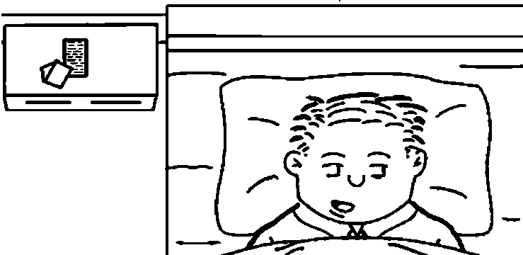
PRECISELY… I JUST RECEIVED THE NOTE, AND I HAVE NOT SPOKEN TO YOU SINCE.

Slide 10
‘BIZARRE’? JOHN, WHY WOULD YOU PARTICIPATE IN SOMETHING WEIRD OR STRANGE FOR THE SCHOOL?
‘BAZAAR’, NOT ‘BIZARRE.’

Slide 11
IN SPITE OF YOU NOT MENTIONING IT TO ME, I WOULD EVEN VENTURE TO SUGGEST THE OBJECT OF THE BAZAAR IS TO ENLARGE THE SCHOOL’S PLAYGROUND.

Slide 13
NOT THE CRICKET FIELD?
THAT’S NEXT YEAR.

Slide 14
THE FACT IS, MY DEAR WATSON, YOU ARE AN EXCELLENT SUBJECT… YOU ARE NEVER BLASÉ… YOU RESPOND INSTANTLY TO ANY EXTERNAL STIMULUS.

Slide 15
YOUR MENTAL PROCESSES MAY BE SLOW.
THAT’S A LITTLE HARSH.

Slide 16
BUT THEY ARE NEVER OBSCURE, AND I FOUND DURING SUPPER YOU WERE EASIER READING THAN THE SCHOOL NEWSPAPER IN FRONT OF ME.

Slide 17
I SHOULD BE GLAD TO KNOW HOW YOU ARRIVED AT YOUR CONCLUSIONS.
OH BOY, ANOTHER MAGIC DEMONSTRATION.

Slide 18
AGAIN, STAMFORD MY GOOD FRIEND… IT IS NOT ANYTHING SUPERNATURAL OR PARANORMAL… I FEAR MY GOOD NATURE IN GIVING EXPLANATIONS HAS SERIOUSLY COMPROMISED MY REPUTATION.

Slide 19
I BELIEVE WE ARE ALL A LITTLE YOUNG TO HAVE FORMED MUCH OF A REPUTATION.
IN THIS CASE, THE TRAIN OF REASONING IS BASED UPON SUCH OBVIOUS FACTS NO CREDIT CAN BE CLAIMED FOR IT.

Slide 21
YOU ENTERED THE DINING HALL WITH A THOUGHTFUL EXPRESSION.
YOU SURE HE DIDN’T JUST HAVE SLEEP CRUD IN HIS EYES FROM HIS AFTERNOON NAP?

Slide 22
IT WAS THE EXPRESSION OF A LAD WHO IS DEBATING SOME VERY DEEP POINT IN HIS MIND.
I DO THAT EVERY MORNING… DO I PEE BEFORE, OR AFTER, BREAKFAST?

Slide 23
IN YOUR HAND YOU HELD A SOLITARY NOTE… BEFORE YOU NAP, YOU WERE IN THE BEST OF SPIRITS, SO IT IS CLEAR THIS LETTER HAS CAUSED THE CHANGE IN YOU.

Slide 24
THIS IS PAINFULLY OBVIOUS.
TO WHO?

Slide 25
TO WHOM?
TO WHOM WHAT?
DROP IT!

Slide 26
IT IS ALL OBVIOUS WHEN IT IS EXPLAINED TO YOU… I NATURALLY ASKED MYSELF WHAT THE LETTER COULD CONTAIN WHICH MIGHT HAVE THIS EFFECT UPON YOU.
AS YOU WALKED TO SUPPER, YOU HELD THE FLAP SIDE OF THE ENVELOPE TOWARDS ME, AND I SAW OUR SCHOOL MASCOT’S FACE STARING BACK AT ME.

Slide 28
IT WAS CLEAR, THEN, THE REQUEST CAME FROM OUR SCHOOL… JUST NOW, YOU LAID THE NOTE ON YOUR BED STAND WITH THE ADDRESS UPPERMOST, AND YOU WALKED OVER TO THE WINDOW.

Slide 29
WHAT NEXT?
I’M STILL NOT SEEING IT.

Slide 30
I GLANCED AT THE ADDRESS, AND I COULD TELL IT WAS AN UNOFFICIAL COMMUNICATION… THIS I GATHERED FROM THE USE OF THE WORD ‘MISTER’ UPON THE SALUTATION.

Slide 31
AS YOU ARE STILL A MINOR, YOU HAVE NO REAL CLAIM TO THAT TERM… I KNEW THE SCHOOL OFFICIALS ARE THE MOST PEDANTIC.
SOMETIMES THE SECOND MOST THAT I KNOW.

Slide 32
IN THEIR CORRECT USE OF TITLES, AND I WAS THUS ENABLED TO SAY WITH CERTAINTY YOUR LETTER WAS UNOFFICIAL… AN OFFICIAL NOTE WOULD HAVE USED THE TERM ‘MASTER’.

Slide 33
WHEN YOU RETURNED TO THE STAND AND TURNED THE NOTE OVER, AND ALLOWED ME TO PERCEIVE THE ENCLOSURE WAS A PRINTED ONE, THE IDEA OF A BAZAAR FIRST OCCURRED TO ME.

Slide 34
THAT SEEMS A LITTLE OF A STRETCH.
I’M GUESSING THERE IS MORE.

Slide 35
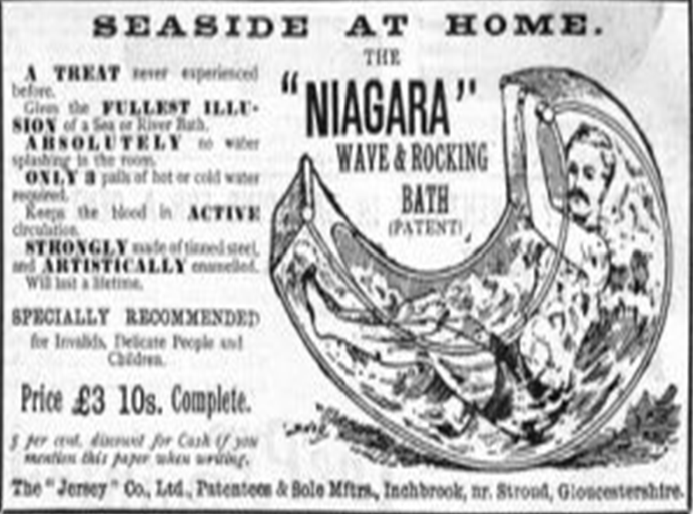

Slide 36
I HAD ALREADY WEIGHED THE POSSIBILITY OF ITS BEING A POLITICAL COMMUNICATION FROM THE STUDENT COUNCIL, BUT THIS SEEMED IMPROBABLE IN THE PRESENT STAGNANT CONDITIONS OF OUR SCHOOL'S POLITICAL STRUCTURE.

Slide 37
WE HAVE A SCHOOL POLITICAL STRUCTURE? TYRRANY BY THE HEADMASTER IS A STRUCTURE?
NOW IS NOT THE TIME TO DISCUSS SUCH WEIGHTY MATTERS.

Slide 38
WHEN YOU CLIMBED INTO BED, YOUR FACE STILL RETAINED ITS EXPRESSION AND IT WAS EVIDENT YOUR EXAMINATION OF THE OUTSIDE WORLD HAD NOT CHANGED THE CURRENT OF YOUR THOUGHTS.

Slide 39
I DETERMINED THE VIEW FROM THE WINDOW MUST ITSELF BEAR UPON THE SUBJECT IN QUESTION.
DOES IT LOOK LIKE RAIN OR SNOW TONIGHT?

Slide 40
I RECALLED THE PLAYGROUND IS SEEN FROM THE WINDOW… I KNOW ITS INADEQUATE SIZE…
…AND OLDER EQUIPMENT HAS BEEN THE DISCUSSION OF STUDENTS FOR THE PAST FEW YEARS, AND EVEN PARENTS HAVE OFFERED TO HELP WITH UPGRADING IT.

Slide 41
GOOD TO SEE YOU, MISTER WATSON.

Slide 42
UNLIKE OTHER SPORTS AT THIS SCHOOL WHERE SPECTATORS HELP FUND THEIR OPERATION, THE PLAYGROUND HAS NO FINANCIAL SUPPORT FROM THE OUTSIDE.
YOU THEN TOOK OUT YOUR PENCIL AND DREW LINES UPON THE ENVELOPE… I AM CONVINCED YOU ARE ENDEAVORING TO REALIZE SOME PROTECTED IMPROVEMENT WHICH WOULD BE BROUGHT ABOUT BY A BAZAAR.

Slide 43
YOUR FACE STILL SHOWED SOME INDECISION, SO I AM ABLE TO BREAK IN UPON YOU WITH MY ADVICE THAT YOU SHOULD ASSIST IN SO GOOD AN 0BJECT… THE YOUNG'UNS WILL ENJOY THE FRUITS OF YOUR LABOURS FOR YEARS TO COME.
EVEN IF IT SIMPLY SELLING BISCUITS OR CAKES DURING THE EVENT.

Slide 44
OF COURSE, IT WAS AS EASY AS POSSIBLE.
WHAT ARE THEY ASKING YOU TO DO… DONATE YOUR ALLOWANCE?

Slide 45
I MAY ADD, THE PARTICULAR HELP WHICH YOU HAVE BEEN ASKED TO GIVE IS TO WRITE IN THEIR ANNUAL, AND YOU HAVE ALREADY MADE UP YOUR MIND THE MY LATEST EXPLOIT WILL BE THE SUBJECT OF YOUR ARTICLE.

Slide 46
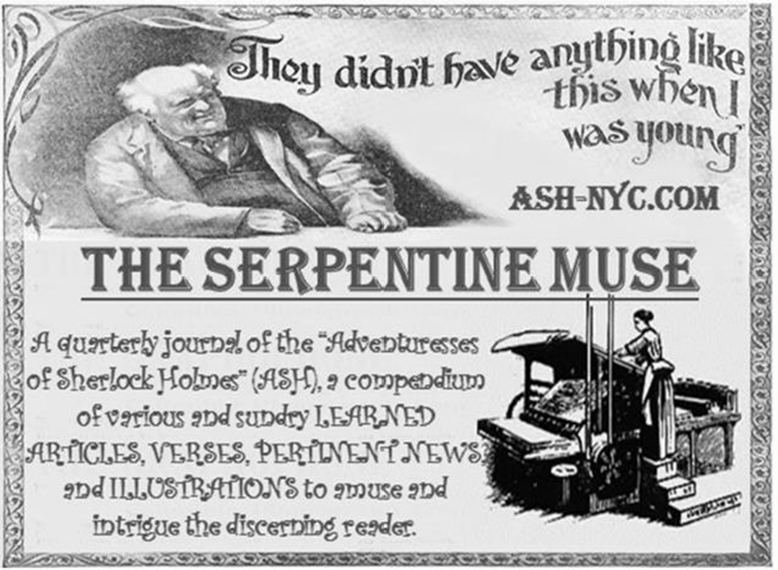

Slide 47
I LEAVE ITS SOLUTION TO YOUR INGENUITY… IN THE MEANTIME, IF YOU WILL EXCUSE ME, I AM OFF TO THE LAND OF MORPHEUS, AS I RISE EARLY TOMORROW TO PROCEED TO THE SCHOOL LIBRARY TO READ AN ARTICLE UPON THE TREES OF CREMONA…
…AND THE EXACT REASONS WHY THEY ARE SO POPULAR IN THE MANUFACTURE OF VIOLINS. IT IS ONE OF THOSE SMALL OUTLYLING PROBLEMS TO WHICH I AM SOMETIMES TEMPTED TO DIRECT MY ATTENTION.

Slide 48
I LIKE TO DIRECT MY ATTENTION TO FOOD, DRINK, AND PLAY… SO MUCH SIMPLER AND SATISFYING.

Slide 49
